Slide 1

Evil Twin attack

Slide 2
Agenda
What is it?
01
How is the attack carried out
02
Impact
03
Mitigation
04
Real-life example and case studies
05
Conclusion
06

Slide 3

What is it?
Rogue wireless access point
Mimics legitimate Wi-Fi
Goal: Trick users into connecting to the fake access point
Notes:
Type of cyberattack where a threat actor sets up a rogue wireless access point that mimics a legitimate one. The goal is to trick users into connecting to the fake access point, which allows the attack to intercept, capture, and manipulate data transmitted by the victim.

Slide 4

How is the attack carried out
Assets under risk: Credentials, personal information, passwords, credit card number….
Vulnerabilities: Weak Wi-Fi security and open networks
Threat: Hackers stealing the data
Threat actor: Hacker setting up the fake Wi-Fi
Vulnerability: Weak Wi-Fi and open networks
Attack surface: Any device that connects to the Wi-Fi
Attack Vector: fake Wi-Fi connection tricking people into using it

Slide 5

Impact
CIA: Only confidentiality, hacker can read everything that is sent

Slide 6
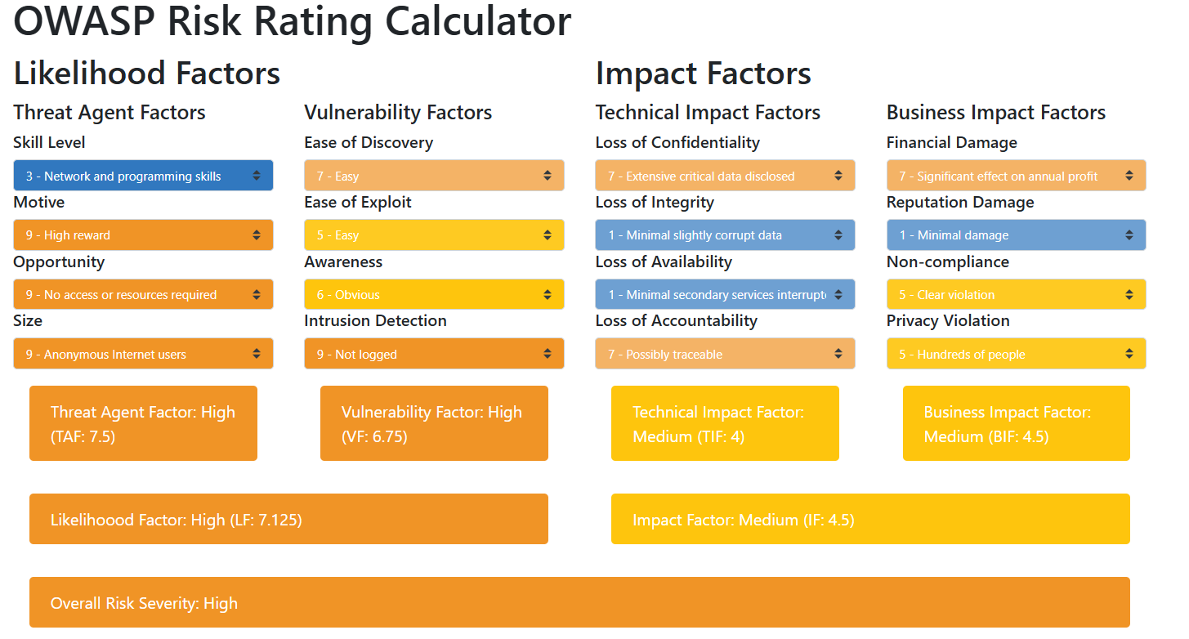

Slide 7
Possible mitigation steps
Only connect to networks you trust
Avoid open Wi-Fi networks
Use secure Wi-Fi with strong password (WPA3 protection)
Use a VPN
MFA

Slide 8

RSA conference
WatchGuard team created an open Wi-Fi hotspots
2,456 attendees’ devices connected to the hotspot
No data was stolen
Notes:
At the RSA Conference, the WatchGuard team conducted an experiment to demonstrate the risks associated with open Wi-Fi hotspots by setting up a rogue access point (AP) that attracted 2,456 attendees’ devices. This experiment highlighted how easily users (even the world’s brightest security experts) can unknowingly connect to unsecured networks, potentially exposing sensitive data to malicious actors
At least, in this case, since the one who created that fake Wi-Fi were “good guys”, they didn’t steal any data.

Slide 9
Evil twin wi-fi during domestic flight
Australian man faces 9 charge for cybercrime offences
Stole dozen credentials
Luring users to enter their credentials before having access to the Wi-Fi, and stored the information
Three counts of unauthorised impairment of electronic communication, contrary to section 477.3 of the Criminal Code Act 1995 (Cth). The maximum penalty for this offence is 10 years’ imprisonment;
Three counts of possession or control of data with the intent to commit a serious offence, contrary to section 478.3 of the Criminal Code Act 1995 (Cth). The maximum penalty for this offence is three years’ imprisonment;
One count of unauthorised access or modification of restricted data, contrary to section 478.1 of the Criminal Code Act 1995 (Cth). The maximum penalty for this offence is two years’ imprisonment.
One count of dishonestly obtain or deal in personal financial information (being usernames and passwords) contrary to section 480.4 of the Criminal Code Act 1995 (Cth); The maximum penalty for this offence is five years’ imprisonment; and
One count of possession of identification information with the intention of committing, or facilitating the commission of, conduct that constitutes the dealing offence, contrary to section 372.2 of the Criminal Code Act 1995 (Cth). The maximum penalty for this offence is three years’ imprisonment.r.

Slide 10

CONCLUSION

